Slide 1
Climate Change project update: week 5
Rens Breunissen,
Lotte van Dongen,
Markus Peschl,
Cecilia Casolo,
Maaike Elgersma,
Eva Slingerland,
Simon van Oosterom
Supervised by
Lorinc Meszaros [Deltares]
Robbert Fokkink [TU Delft]
Mathematical Data Science

Slide 2
Github
We used a Github drive in order to share codes and results. You can join the drive and view our progress with the following link:

Slide 3
This week we worked on:
Finishing the research on clustering and Neural Networks
Writing the report

Slide 4
Clustering
We finished a verification measure for the number of clusters
We Generated the clusters for all different models, stations, and scenarios
Finally, we combined this with the code that analyzes the changes between the early and late years

Slide 5
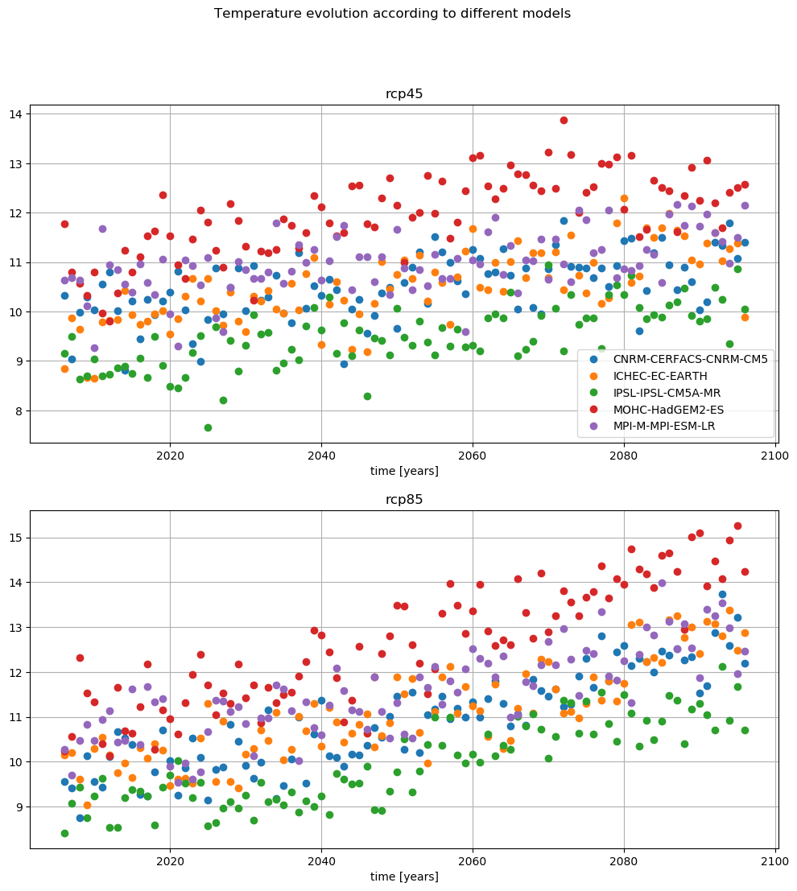
Analyzing the clusters
Figure from the pre-analysis
As an example we can compare two models with the two different scenarios.
Here, one can see that the MOHC predicts an extreme rise in temperature while CNRM is more or less the average of the models, so we can compare those

Slide 6
Clustering verification
Figure from the pre-analysis
As an example we can compare two models with the two different scenarios.
Here, one can see that the MOHC predicts an extreme rise in temperature while CNRM is more or less the average of the models, so we can compare those

Slide 7
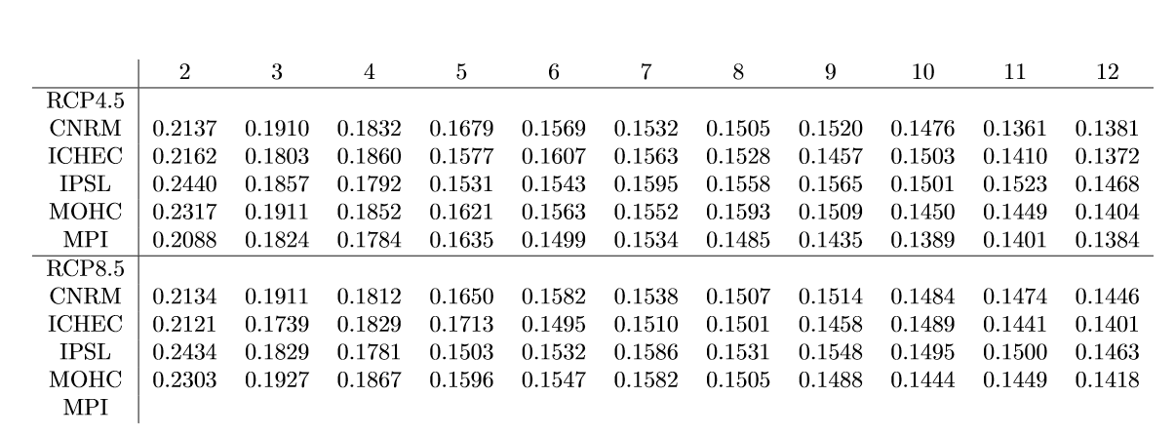
Validating the clusters
The number of clusters that we have used (often either 2 or 4) had been chosen on intuition.
However, the quality of the clusters can be numerically expressed with validation methods (we used the silhouette score where higher => better).
One can observe that there is a steep drop from 2 to 3 clusters and from 4 to 5 clusters. However, in general, the silhouette score decreases when we increase the number of clusters.
However, we feel that 2 clusters hides to much of the information, so we used more.

Slide 8
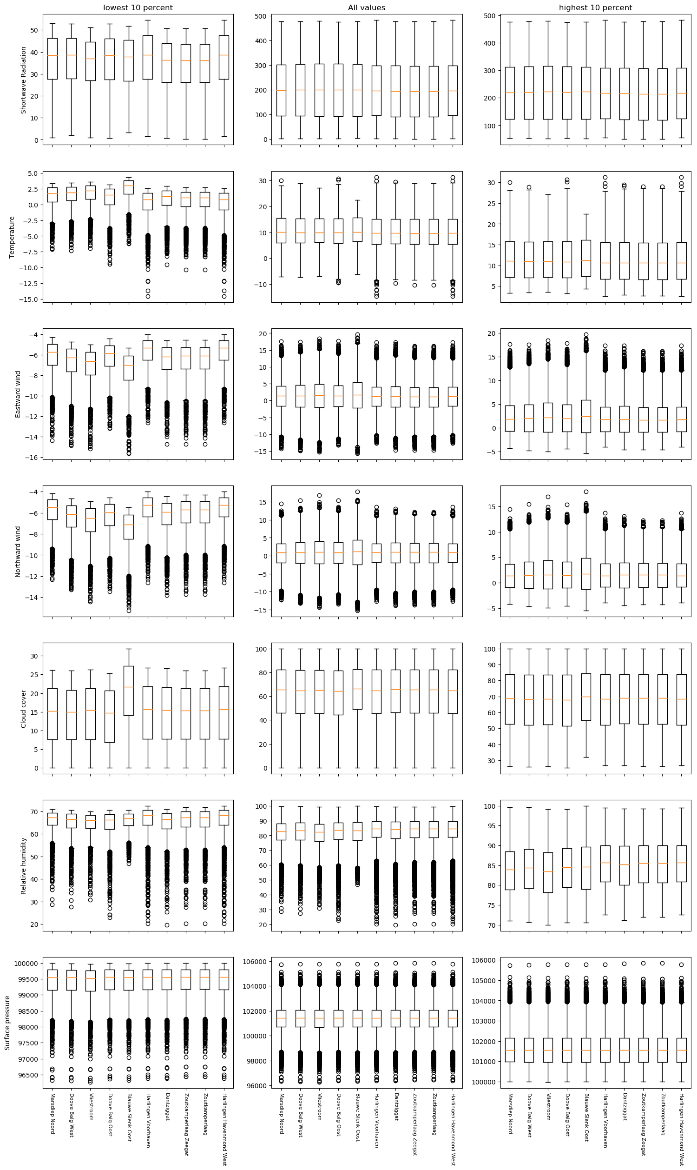
Comparing the stations
Secondly, we created the following charts which summarize all of the data from all stations for one model and one scenario.
We are going to use it in the pre-analysis in the report in order to point out what the interesting cases are .
One word of warning, it is rather big and definitely won’t be used in the final presentation.
Each row represents a variable, the left and right column are the extreme days (highest and lowest 10 %)

Slide 9
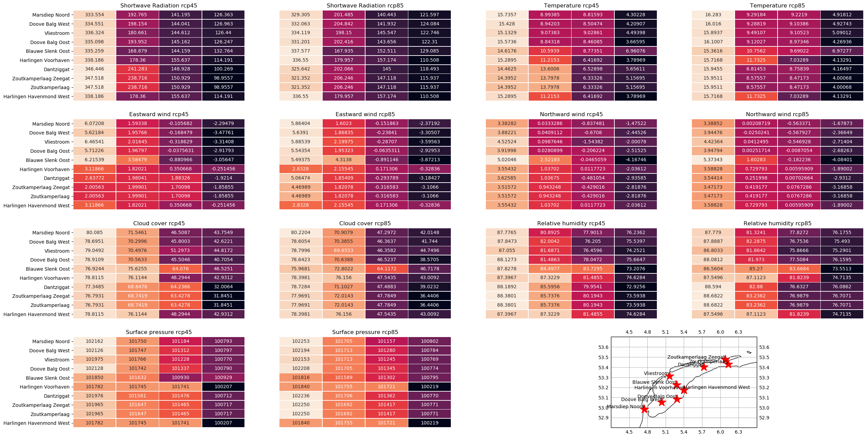
Comparing the different models
In order to analyze the differences between the models, we constructed the 4 clusters for every station, model, and scenario.
These are a lot of numbers for one slide, but the colors are more important: the more the colors vary along one column, the less the models agree.
Model 1: CNRM-CERFACS-CNRM-CM5

Slide 10
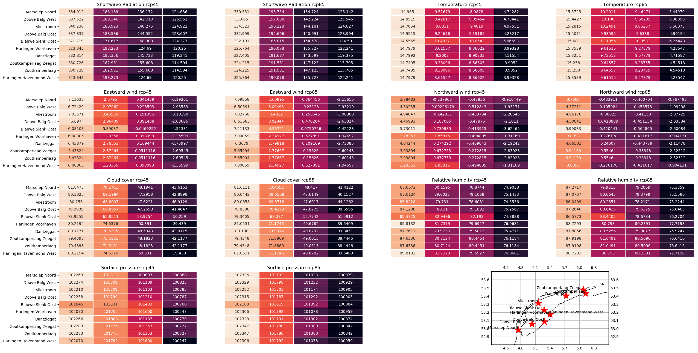
Comparing the different models
In order to analyze the differences between the models, we constructed the 4 clusters for every station, model, and scenario.
These are a lot of numbers for one slide, but the colors are more important: the more the colors vary along one column, the less the models agree.
Model 2: ICHEC-EC-EARTH

Slide 11
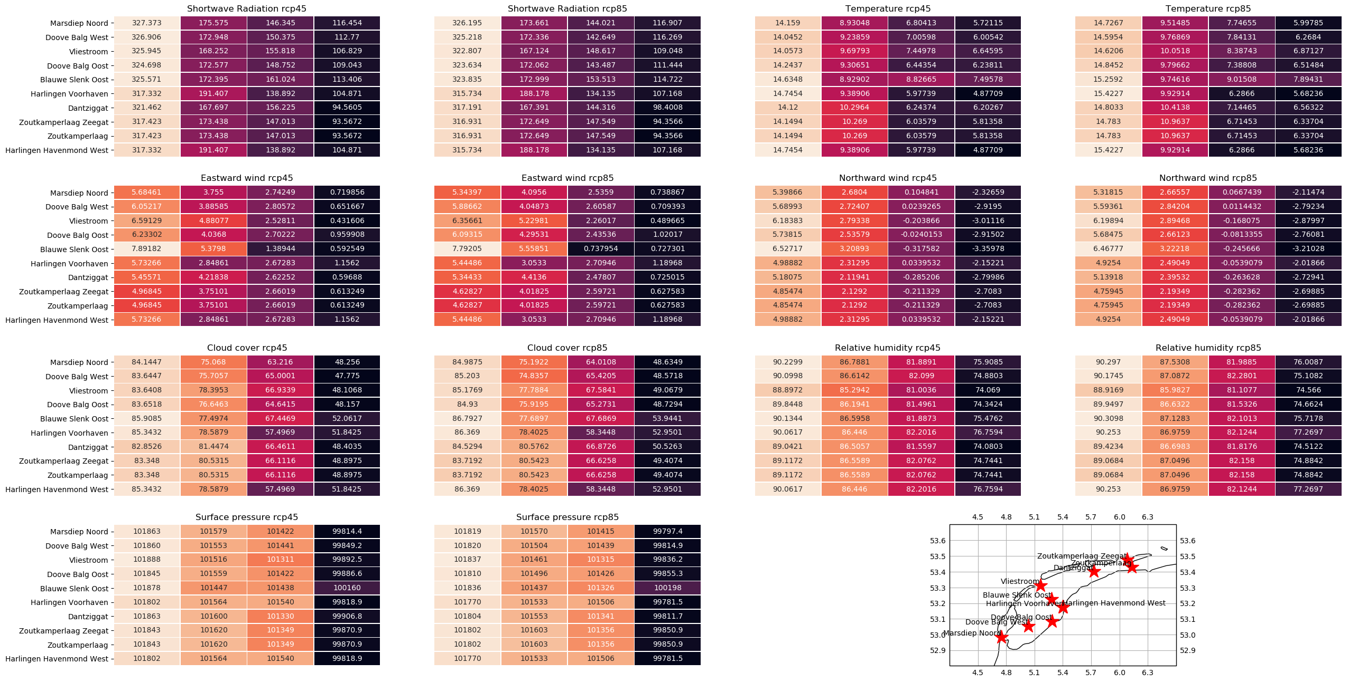
Comparing the different models
In order to analyze the differences between the models, we constructed the 4 clusters for every station, model, and scenario.
These are a lot of numbers for one slide, but the colors are more important: the more the colors vary along one column, the less the models agree.
Model 3: IPSL-IPSL-CM5A-MR

Slide 12
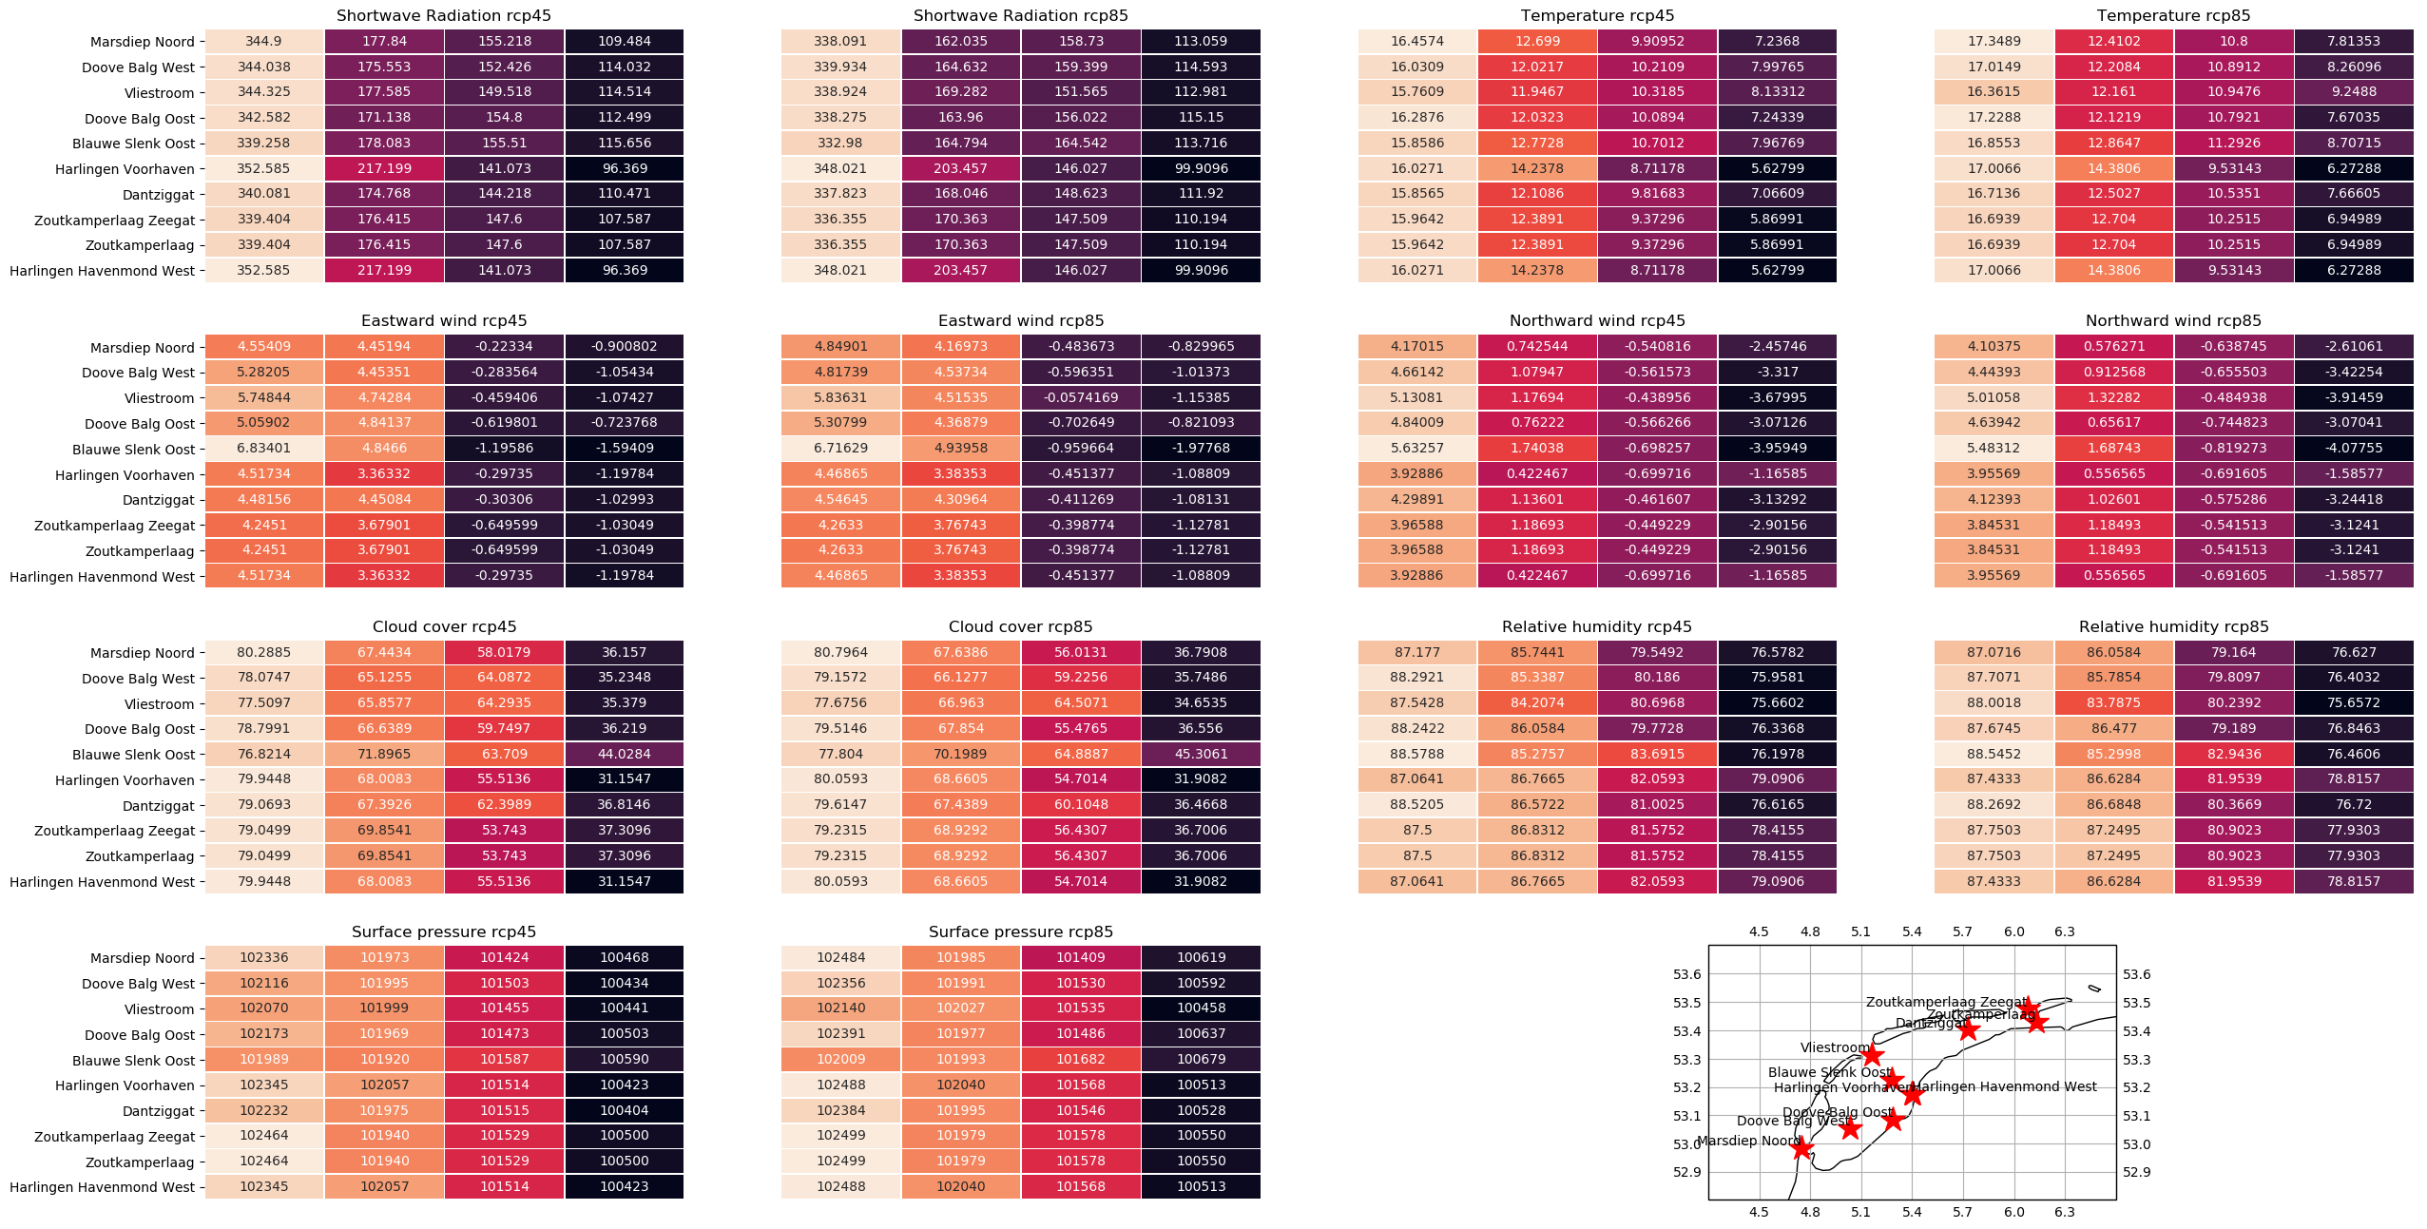
Comparing the different models
In order to analyze the differences between the models, we constructed the 4 clusters for every station, model, and scenario.
These are a lot of numbers for one slide, but the colors are more important: the more the colors vary along one column, the less the models agree.
Model 4: MOHC-HadGEM2-ES

Slide 13
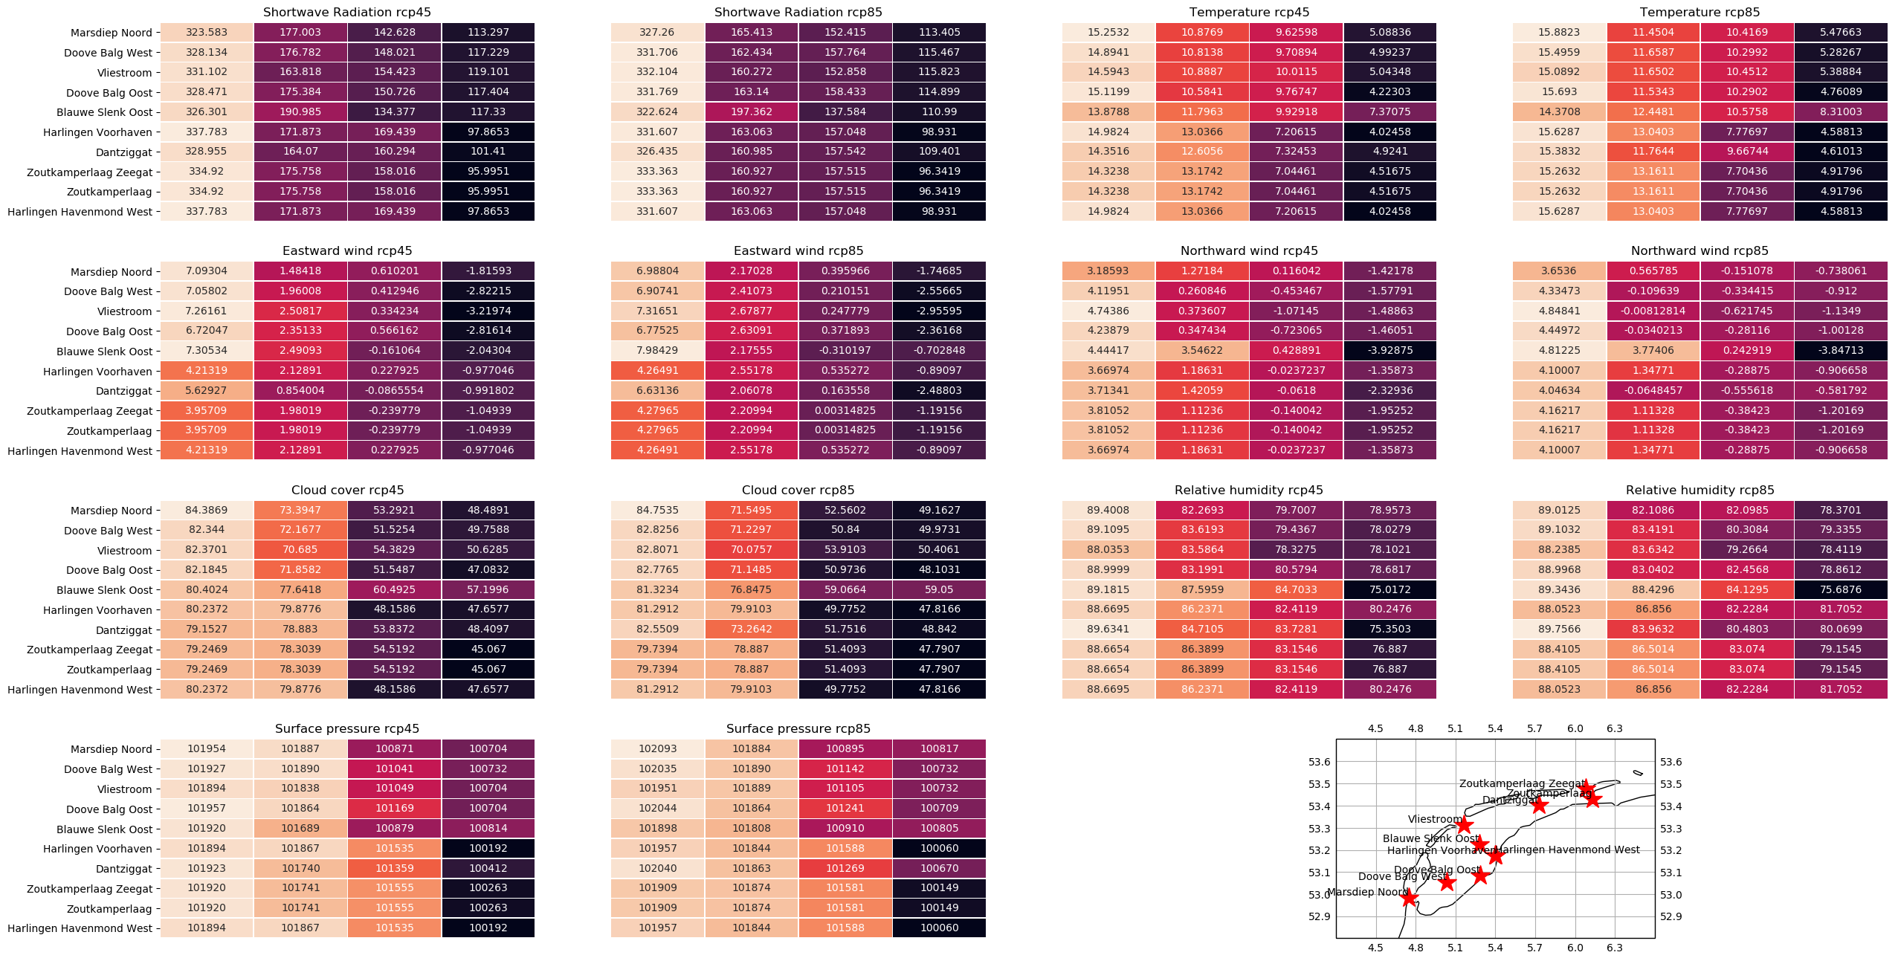
Comparing the different models
In order to analyze the differences between the models, we constructed the 4 clusters for every station, model, and scenario.
These are a lot of numbers for one slide, but the colors are more important: the more the colors vary along one column, the less the models agree.
Model 5: MPI-M-MPI-ESM-LR

Slide 14
Clustering final remarks
To Do:
Look at the KNMI/IPCC/Cordex reports in order to find nice ways of vizualizing the data
Expand the validation of the clusters
Combine the code for comparing the first and last 10 years and the code for analyzing the clusters.
Possibly ignore one (or more) variables in order to generate other clusters
Implement spatial clustering on the original dataset (when there is time left)

Slide 15
Model prediction
Furthermore, we looked into the possibility of predicting the variables from one model based on the values from another model and a part of its own history.
First steps into multi linear regression were done, however the results will be shown next week.
Other methods used are neural networks and K-means

Slide 16
Model Prediction using dense ANN’s final remarks
To do: Generalize this to different models and compare performances as well as to play around with the training set size (e.g. only having the first 100 days poses a bigger challenge since the network never gets to see certain months)
Questions that arise here: How to make the task more challenging? What other predictions could be useful in this context?

